Slide 1
3 Golden Ratios
of Top
Customer Impact

Slide 2
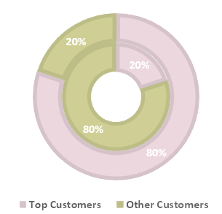
Ratio 1 - 20/80
(Pareto Principle)
20% Top Customers Contribute 80% Spending
Inner Layer:
#Customer
Outer Layer:
$Customer

Slide 3
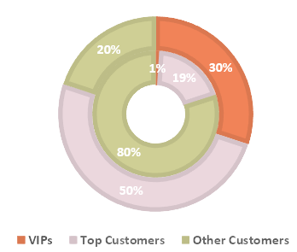
Ratio 2 – 1/30
1% VIPs Contribute 30% Spending
Inner Layer:
#Customer
Outer Layer:
$Customer

Slide 4
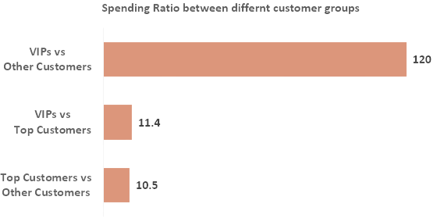
Ratio 3 - 1/120
VIPs’ spending is 120 times more than other customers and 11.4 times more than top customers.

Slide 5
The 3 golden ratios demonstrate the importance of VIPs and top customers in the business.
Enlarging VIPs and top customer base through creating:
Memorable Customer Experience
-
Personalised & Meaningful Relationship

